Slide 1

Concurrent Programming
Ericsson CGC Johnson Chen Bell Fan Owen Li

Slide 2


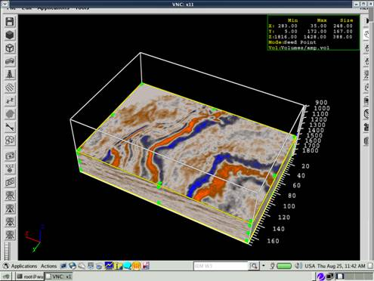
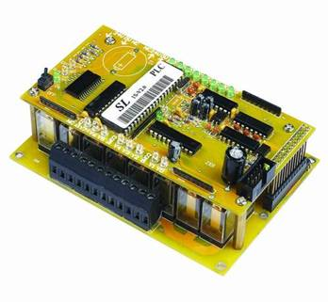

concurrent program introduction
Where concurrent program is used in?

Slide 3
concurrent program introduction
Four steps in creating a concurrent program
- Parallelized? - Partition - Granularity
Partitioning
- Load Balancing - Data Dependencies
- Communications - Synchronization
Decomposition
Assignment
Orchestration
Mapping
P0
P1
P0
P1
P1
P2
P2
P3
P3
P4
P2
P3
Sequential computation
Tasks
Processes
Parallel program
Processors

Slide 4
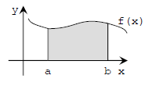

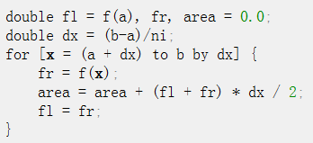
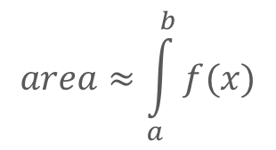
concurrent program introduction
Example: The quadrature problem
Compute an approximation of the integral of a continuous function ƒ(x) on the interval from a to b
$$area≈\int_{a}^{b}{f(x)}$$
Sequential iterative quadrature program

Slide 5
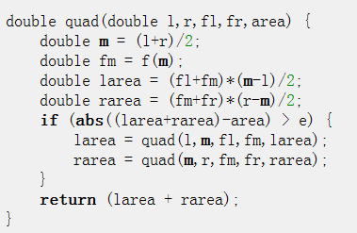
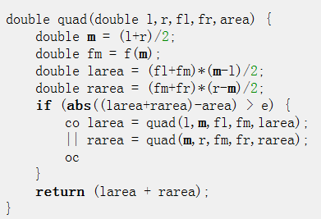
concurrent program introduction
Example: The quadrature problem
Sequential procedure
Parallel procedure
Usage: area = quad(a, b, f(a), f(b), (f(a)+f(b))*(b-a)/2)
Two recursive calls are independent and can be executed in parallel

Slide 6
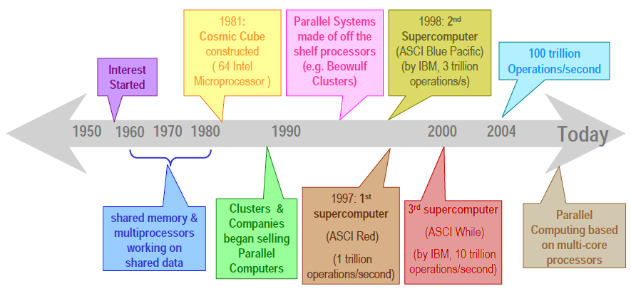
concurrent program introduction
History of Concurrent program

Slide 7
Parallel Computing Memory Architecture
Shared Memory Architecture
Distributed Memory Architecture
Hybrid Distributed‐Shared Memory Architecture
Shared Memory
Distributed Memory
Distributed Shared Memory

Slide 8
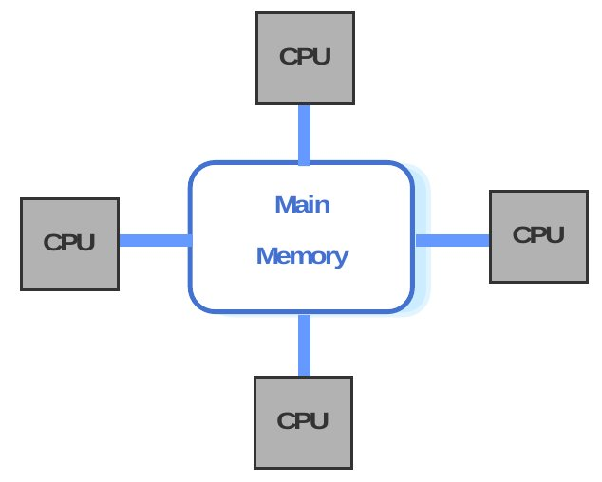
Parallel Computing Memory Architecture
紧耦合的共享存储结构 (Shared Memory Architecture)
特点:
- 多个处理器
- 全局一致访问的物理存储
- UMA, Uniform Memory Access
Pros & Cons: - 编程简单 - 易引起数据冲突
SMP, Symmetrical MultiProcessors
支持SMP处理器: Intel Xeon, AMD athlon64

Slide 9
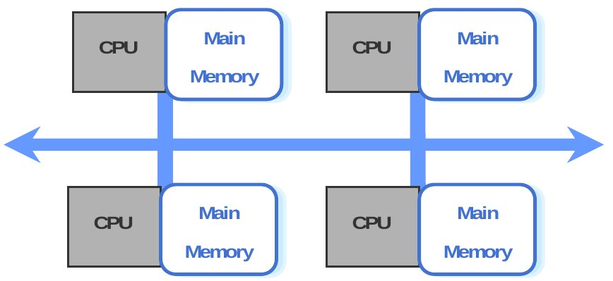
Parallel Computing Memory Architecture
松耦合的分布式存储结构 (Distributed Memory Architecture)
特点: - 多个处理节点 - 网络连接 - 消息传递进行通讯
Pros & Cons: - 可扩展性高 - 编程较困难
分类： - 大规模并行处理机(MPP) - 集群(Cluster) - 网格(Grid)

Slide 10
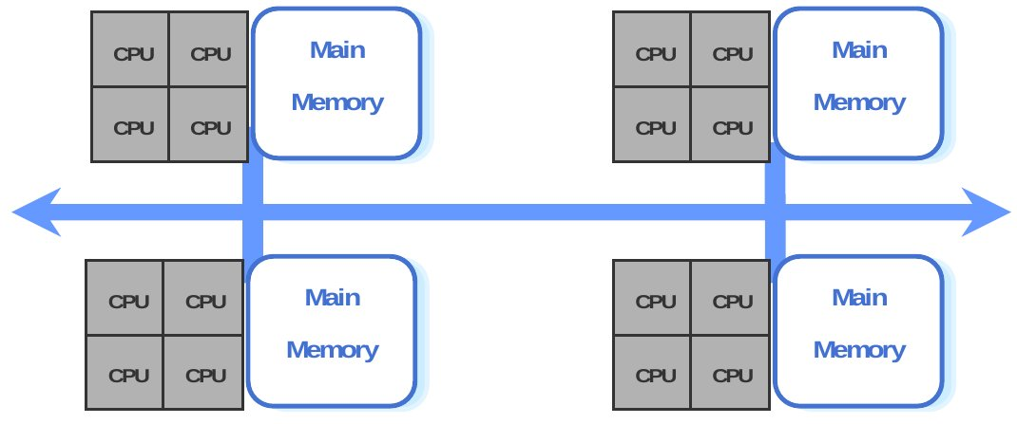
Parallel Computing Memory Architecture
混合的分布式共享存储结构 (Shared Memory Architecture)
特点: - 物理上分布逻辑上共享 -全局共享虚拟存储器 - NUMA
分类： - 微机机群(PC cluster) - 工作站机群(NOW)
DSM操作系统

Slide 11
Concurrent Programming

Slide 12

Agander
线程安全
锁优化
Monitor模式

Slide 13
Agander
线程安全
锁优化
Monitor模式

Slide 14


Thread safety
A class is thread-safe if it behaves correctly when accessed from multiple threads, regardless of the scheduling or interleaving of the execution of those threads by the runtime environment, and with no additional synchronization or other coordination on the part of the calling code.
Java Concurrency In Practice Joshua Bloch

Slide 15

Thread safety
System.setIn()
System.setOut()
不可变对象
Thread-hostile
Immutable
Degrees of Thread Safety
Thread compatible
ArrayList HashMap …
Thread-safe
绝对安全? Vector?
Conditionally thread-safe
java.utils.*

Slide 16

Thread safety
线程安全的实现方法
Mutual Exclusion & Synchronization
Non-Blocking Synchronization
Thread Confinement
Actor Model

Slide 17
Thread safety
互斥同步(Mutual Exclusion & Synchronization)
同步与互斥 互斥是因，同步是果 互斥是方法，同步是目的
四大利器： ReentrantLock， CountDownLatch， CyclicBarrier， Semaphore

Slide 18
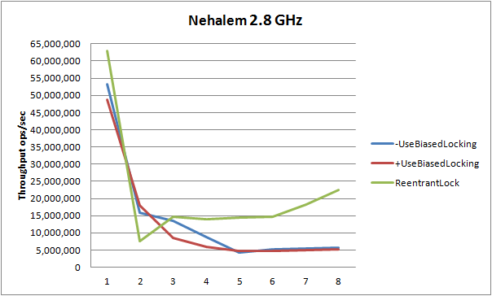
Thread safety
互斥同步(Mutual Exclusion & Synchronization)
Synchronized与ReentrantLock
ReentrantLock
支持等待中断
支持公平锁
支持绑定多条件
Synchronized：
自动释放
可读性好
JDK自优化
Notes:
ReadWriteLock

Slide 19
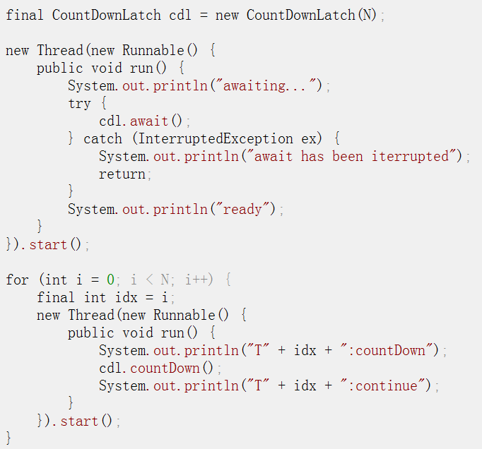
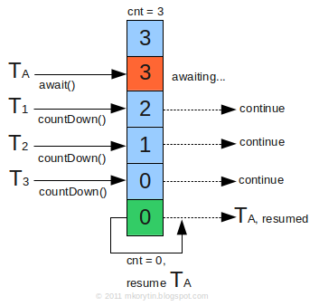
Thread safety
互斥同步(Mutual Exclusion & Synchronization)
CountDownLatch

Slide 20
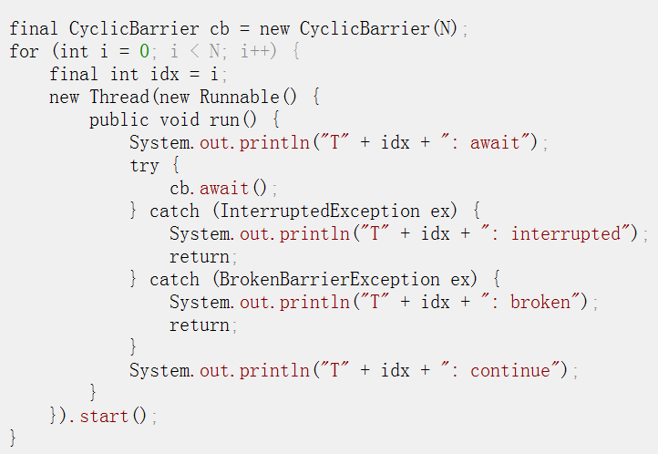
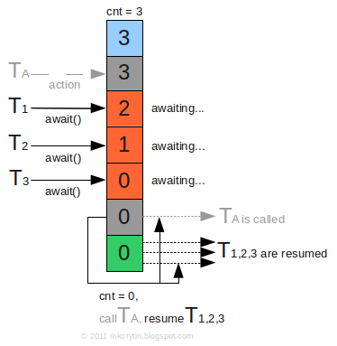
Thread safety
互斥同步(Mutual Exclusion & Synchronization)
CyclicBarrier

Slide 21
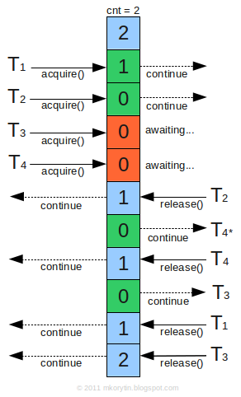
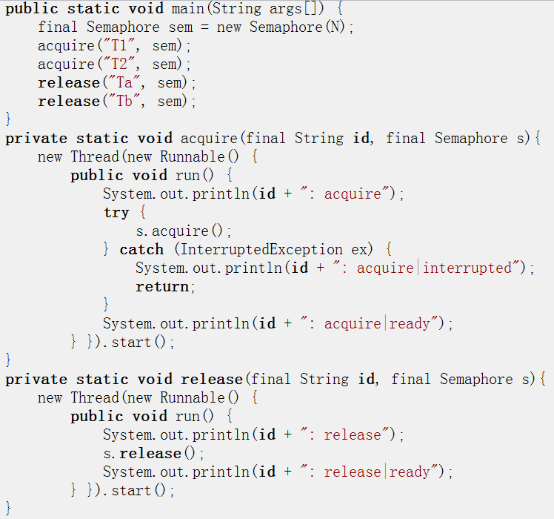
Thread safety
互斥同步(Mutual Exclusion & Synchronization)
Semaphore

Slide 22
Thread safety
非阻塞同步(Non-Blocking Synchronization)
基于冲突检测的乐观的并发策略 先进行操作，如果没有其它线程争用共享数据，那操作就成功了。如果有共享数据争用,那就产生了冲突，然后就不断重试直到成功为止。

Slide 23
Thread safety
非阻塞同步(Non-Blocking Synchronization)
CAS(Compare-and-Swap)
Compared valued
Swap value
no
Destination == Compared value
yes
Destination unchanged
Destination = Swap value

Slide 24
Thread safety
非阻塞同步(Non-Blocking Synchronization)
Wait-Free, Lock-free
java.util.concurrent.atomic
AtomicBoolean, AtomicInteger, AtomicLong, AtomicReference<V>,
用于实现J.U.C里非阻塞算法相关的栈，队列，哈希表
Pros & Cons
性能超过锁的性能
编程方式和验证非常困难

Slide 25
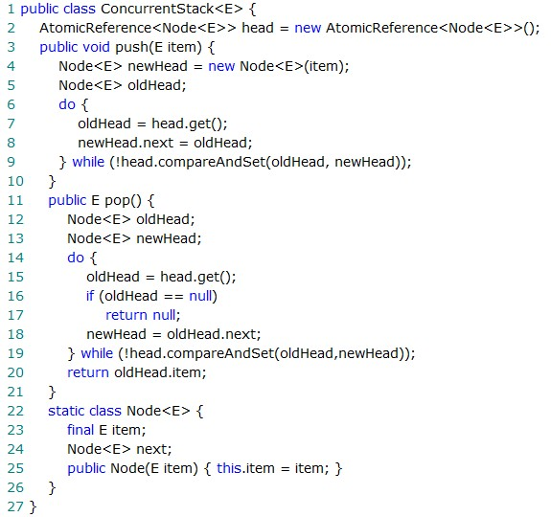
Thread safety
非阻塞同步(Non-Blocking Synchronization)

Slide 26
Thread safety
线程封闭(Thread Confinement)
相见，不如不见
ThreadLocal 方便，避免调用每个方法时都要传递执行上下文信息 代码和框架耦合在一起，降低了代码的可重用性

Slide 27
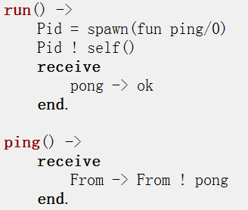
Thread safety
Actor并发模型
锁模型的问题
不确定性
死锁和争用冲突
“不共享数据，消息传递”模型
世界是并发的
事物时间不共享数据
事物通过消息进行通信
事物会出现故障

Slide 28
Agander
线程安全
锁优化
Monitor模式

Slide 29
Optimize locks
在多个线程的协调和调度必然需要一定的性能开销，所以有时候为了提升性能而引入多线程，反而开销的消耗超过提升的幅度。

Slide 30

Optimize locks
当数据竞争不可避免需要用到锁的时候
减少锁的持有时间
降低锁的请求频率

Slide 31
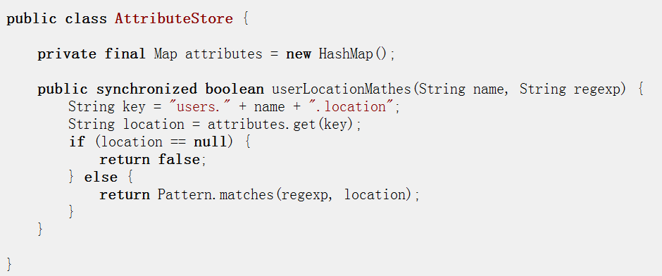
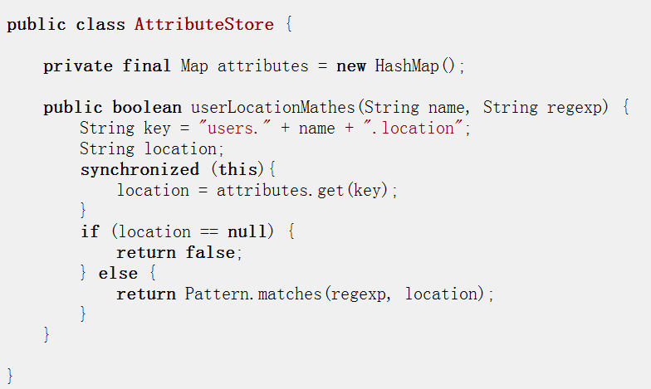
Optimize locks -- 减少锁的持有时间
移除锁无关的代码出临界区

Slide 32

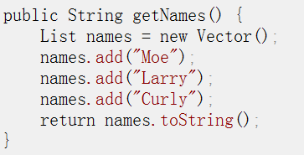
Optimize locks -- 减少锁的持有时间
减少同步开销
锁消除 去掉一些不会发生竞争的锁，从而减少不必要的同步开销
锁粗化 将邻近的同步代码块用同一个锁合并起来
自旋锁 通过循环不断地尝试获取锁，直到成功 -XX:+UseSpinning

Slide 33
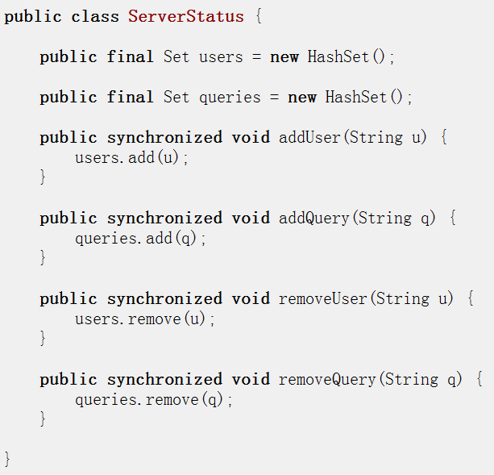
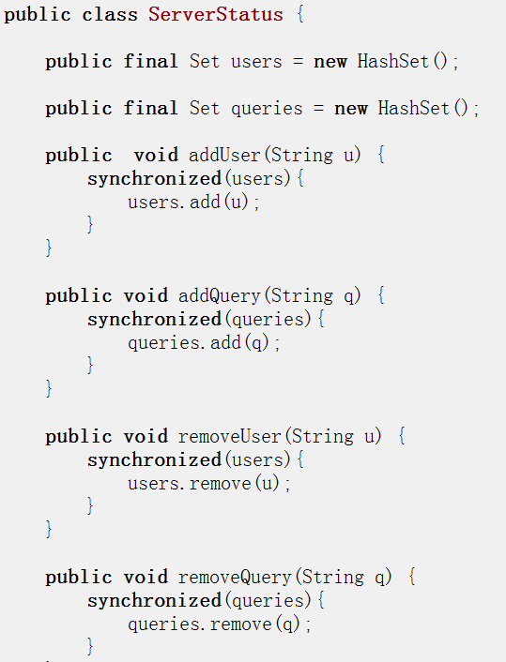
Optimize locks --降低锁的请求频率
锁分解

Slide 34
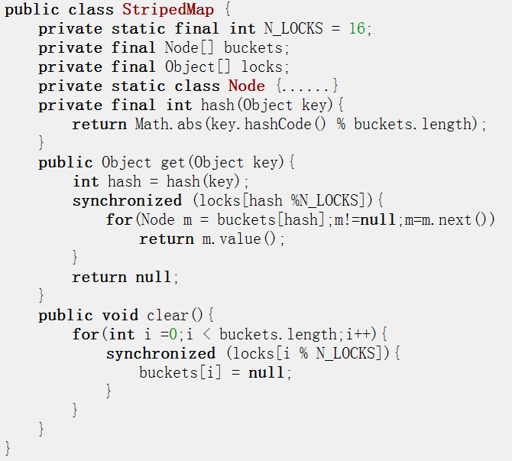
Optimize locks --降低锁的请求频率
锁分段

Slide 35
Optimize locks – 关于性能优化
We should forget about small efficiencies, say about 97% of the time: premature optimization is the root of all evil.
不要过早优化
基准测试是必须的
要适可而止，不要追求极致
The Art of Computer Programming Donal Knuth

Slide 36
Agander
线程安全
锁优化
Monitor模式

Slide 37
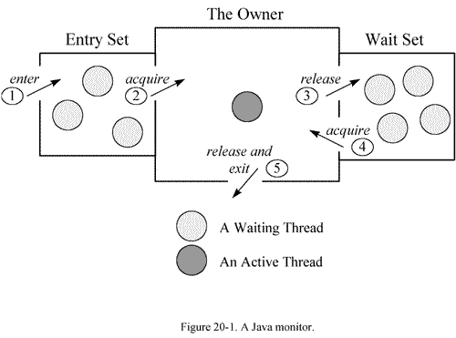
Monitor pattern
Monitor is a programming language construct (e.g. a class) which encapsulates variables, access procedures and initialization code within an abstract data type.
– Monitor variables represent a state of an instance of the monitor;
– Monitor procedures (a.k.a. operations or methods) are the only means to access (to inspect and to alter) the monitor variables;
– Monitor procedures are executed with mutual exclusion.
Notes:
http://www.artima.com/insidejvm/ed2/threadsynch.html

Slide 38
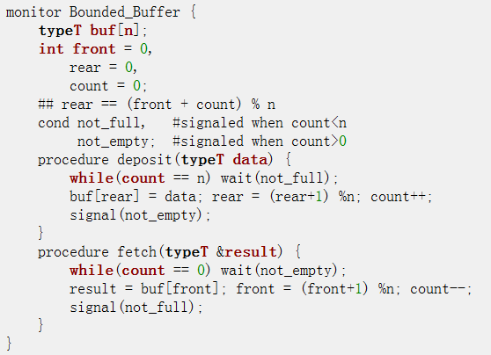
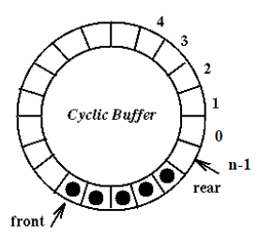
Monitor pattern
Example 1: Bounded buffers
Usage:
–In Producer:
Bounded_Buffer.deposit(a[i]);
–In Consumer:
Bounded_Buffer.fetch(&a[i]);

Slide 39
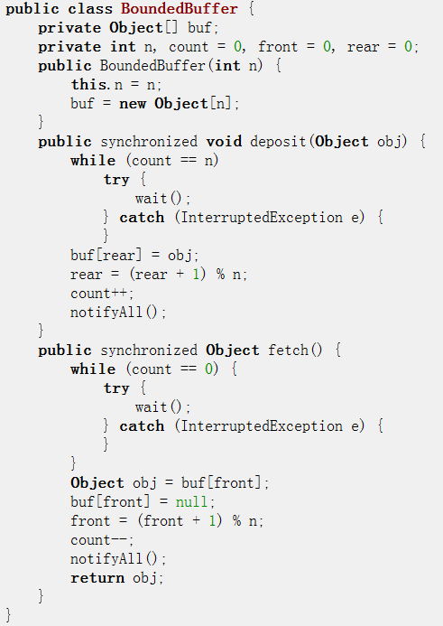
Monitor pattern
Example 1: Bounded buffers
Methods deposit and fetch are synchronized (to be executed with mutual exclusion)
Condition variable is implicit - methods wait, notify, notifyAll

Slide 40
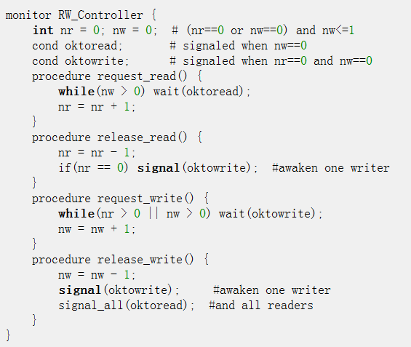
Monitor pattern
Example 2: Readers and Writers
Usage:
In Reader:
RW_Controller.request_read();
read the database;
RW_Controller.release_read();
In Writer:
RW_Controller.request_write();
write the database;
RW_Controller.release_write();

Slide 41
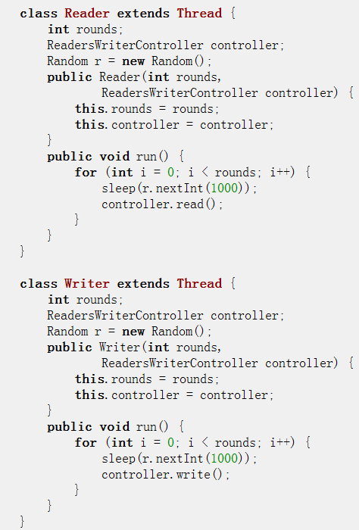
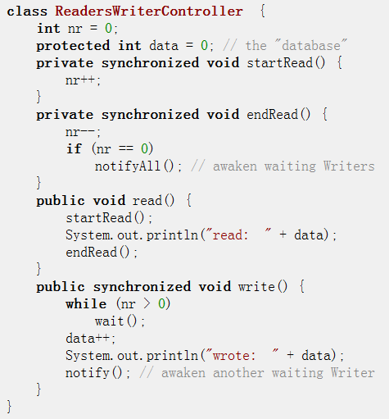
Monitor pattern
Example 2: Readers and Writers
Usage:

Slide 42
Monitor pattern
Exercises
A Fuel Space Station (a resource management problem)
The Dining Philosophers problem (deadlock)
The Hungry Birds Problem (one producer - multiple consumers)
The Bear and Honeybees Problem (multiple producers - one consumer)
The One-Lane Bridge Problem (similar to the Readers/Writers problem)
The Unisex Bathroom Problem (similar to the Readers/Writers problem)

Slide 43


